Slide 1

PhD Candidacy Proposal – Milestone 2
Deriving Knowledge from Attribute Labels for
Data Quality Assessment
Marcelo Valentim Silva - 20882194
Primary supervisor – Dr Johannes Herrmann
Co-supervisor – Dr Valerie Maxville
Committee Chairperson – Prof Tele Tan
A global university Western Australia | Dubai | Malaysia | Mauritius | Singapore

Slide 2

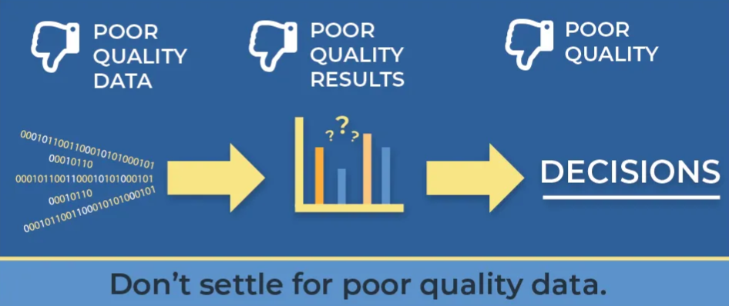

Importance of data quality in the decision-making process
https://polestarsolutions.medium.com/how-poor-data-quality-negatively-impacts-your-organization-61dfa74ba63f
Notes:
This emphasises the critical need for robust data quality management practices and the demand for comprehensive strategies and tools to address these prevalent issues.

Slide 3
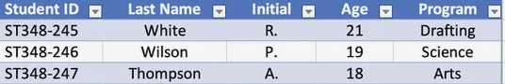
The Potential of Attribute Labels for Improving Data Quality
Attributes in datasets, like
columns or fields in tables,
usually have a label or a name,
which may be a word or a phrase.
e.g.: ‘ID’, ‘name’, ‘age’ in Attribute labels/ Column names
Notes:
This emphasises the critical need for robust data quality management practices and the demand for comprehensive strategies and tools to address these prevalent issues.

Slide 4
Aims and Objectives
Aim of the Study: To enhance data quality assessment methods through semantic analysis of attribute labels
Objectives:
Develop dictionaries for semantic detection.
Identify data types from attribute labels.
Integrate semantic type detection into data quality assessments, aligning with scholarly rigour.
Evaluate these methods against conventional tools.
Disseminate the findings to benefit the research community and industry.
Notes:
Data Quality is the area I pursued my Master’s Degree in the USA. It is and will always be the background for me. I have been responsible to this area in my organization for many years.

Slide 5
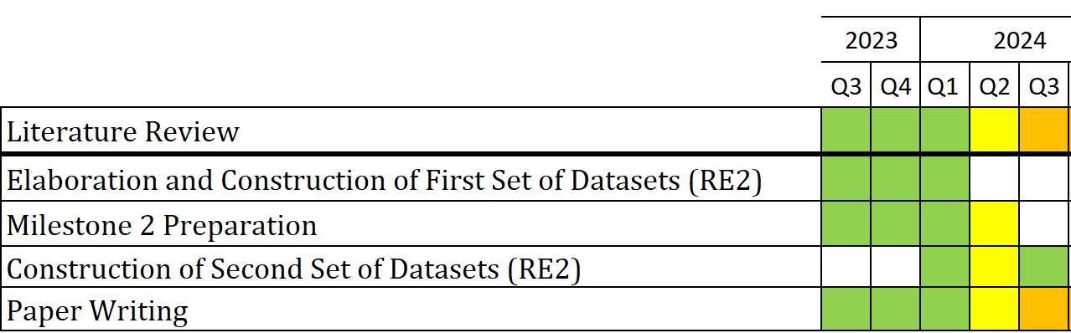
Research Progress
Achievements since Milestone 1 according to Timeline, Unified Process Methodology and Research Elements:
Notes:
This emphasises the critical need for robust data quality management practices and the demand for comprehensive strategies and tools to address these prevalent issues.

Slide 6

Research Progress
Notable Developments:
Consultation with Professor Felix Naumann, editor of ACM JDIQ.
Division of original paper into the paper for Milestone 2 and rest of PhD.
Submission Requirements for Milestone 2:
A substantive sample of work, with minimum of 3000 words, not the initial research proposal, and it could be a draft or published journal article:
a draft suitable for a database conference, according to the advice of Professor Naumann.
Notes:
This emphasises the critical need for robust data quality management practices and the demand for comprehensive strategies and tools to address these prevalent issues.

Slide 7

Research Question
"How does semantic analysis of attribute labels,
using comprehensive dictionaries,
enhance data type/format detection, and
improve data quality assessment compared to existing tools across various datasets and
domains?"
Notes:
Data Quality is the area I pursued my Master’s Degree in the USA. It is and will always be the background for me. I have been responsible to this area in my organization for many years.

Slide 8
Background/ Literature review

Slide 9
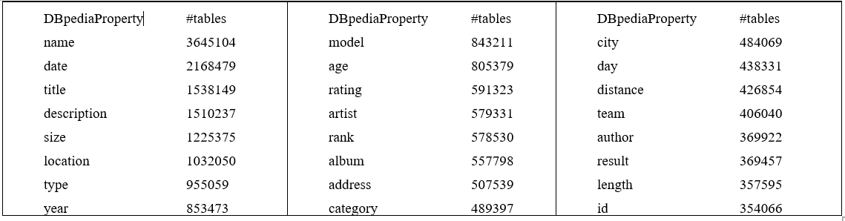
A Study with 90 million tables from Web Table Corpus/DBPedia
obtained 1100 words from column names.
Web Data Commons [Ristoski et al., 2012]
Notes:
This emphasises the critical need for robust data quality management practices and the demand for comprehensive strategies and tools to address these prevalent issues.

Slide 10
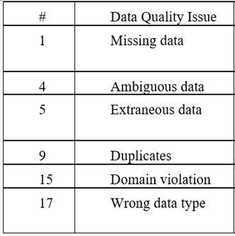
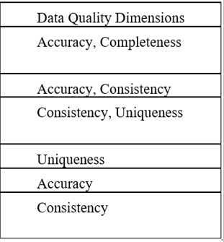
22 well-known Data Quality Issues
[Visengeriyeva and Abedjan, 2020](Appendix 1 from Milestone 1)
The most common Data Quality Issues according to our research
Notes:
This emphasises the critical need for robust data quality management practices and the demand for comprehensive strategies and tools to address these prevalent issues.

Slide 11
Semantic Type Detection
Sherlock [Hulsebos et al., 2019] :
Deep neural network for semantic type detection, trained on over 680,000 data columns, matched 78 semantic types to
column headers from DBPedia.
AUTOTYPE [Yan and He, 2018]: Synthesized type detection logic from data types by using code from open-source repositories like GitHub and detected 84 semantic types.
Notes:
This emphasises the critical need for robust data quality management practices and the demand for comprehensive strategies and tools to address these prevalent issues.

Slide 12
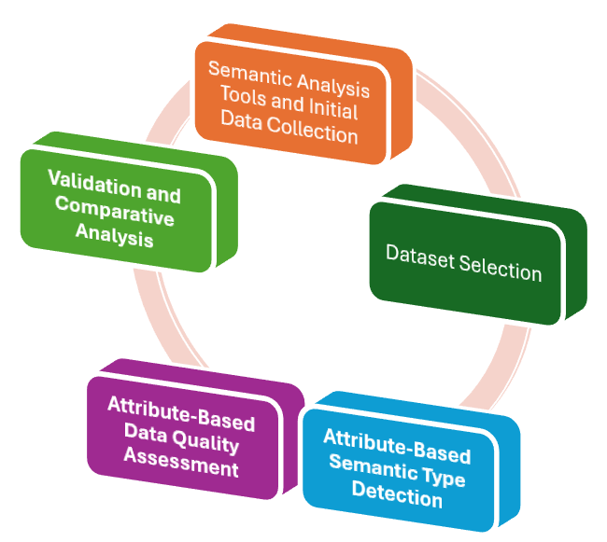
Methodology

Slide 13
Methodology – Quantitative/Qualitative
Semantic Analysis Tools and Initial Data Collection - quantitative data analysis techniques
Dataset Selection - quantitative metrics
Attribute-Based Semantic Type Detection - descriptive analysis, text mining, and rule-based classification - quantitative techniques augmented with qualitative refinement
Attribute-Based Data Quality Assessment - a hybrid approach that leverages quantitative insights from semantic type detection to assess dataset attributes, complemented by qualitative analyses
Validation and Comparative Analysis - quantitative data analysis and qualitative insights

Slide 14
RESULTS

Slide 15
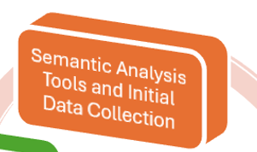
Back to Methodology

Slide 16
Semantic Analysis Tools & Initial Data Collection
Formats Dictionary:
'id':'ID column',
'percentage':'percentage',
'weight':'numerical >= 0',
'predicted':'categorical',
'integer':'numerical',
'boolean':'binary',
'town':'city',
'province':'state',
'day and time':'datetime',
'text':'string',
Milestone 1
Abbreviations Dictionary:
accg: accounting
acous: acoustics

Slide 17
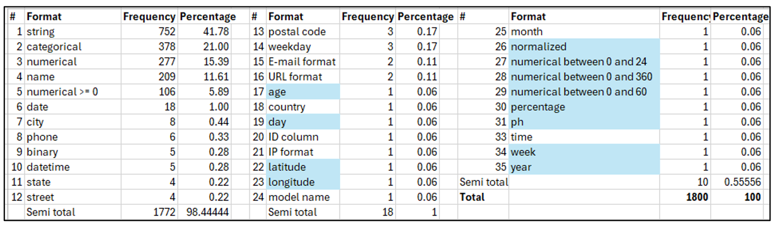
Semantic Analysis Tools & Initial Data Collection
Frequency distribution of the 1800 words in the Formats Dictionary:

Slide 18
Semantic Analysis Tools & Initial Data Collection
Information from all 622 datasets available in the UCI Machine Learning Repository Catalogue was obtained.
Milestone 1

Slide 19

Back to Methodology

Slide 20
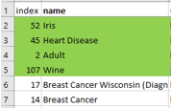
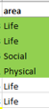
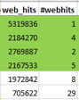
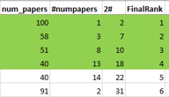
First Dataset Selection
Ten datasets from five areas were chosen considering their web_hits and number of papers associated.
Milestone 1

Slide 21
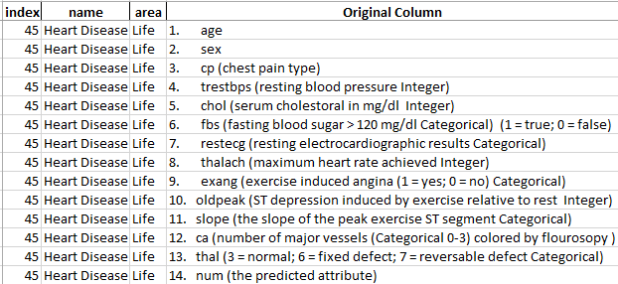
First Dataset Selection
Here are all attribute labels obtained for Dataset 45:

Slide 22
Second Dataset Selection
Forty datasets from six different areas were chosen based on their number of web hits
Milestone 1

Slide 23
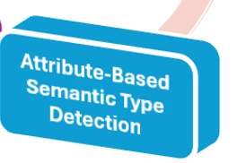
Back to Methodology

Slide 24
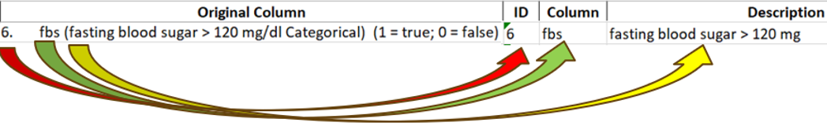
Attribute-Based Semantic Type Detection
The algorithm and explanations are in the Appendices.
Here is the separation into ID, Column, and Description(s):
The description(s) contains what comes after the symbols '(' or ':' or '/'.
Milestone 1

Slide 25
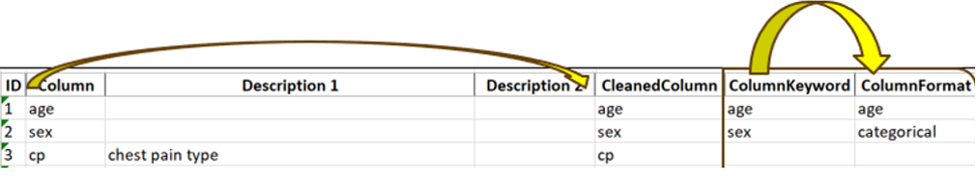
Attribute-Based Semantic Type Detection
Here, the column is cleaned (lowercase and deletion of ‘-’ and ‘_’) and then searched for in the formats’ dictionary
If the word is found there, the format associated is inserted into the ColumnFormat.
Milestone 1

Slide 26
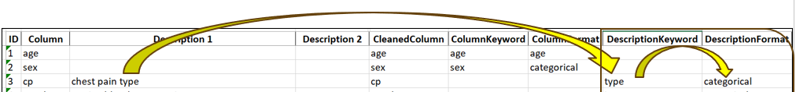
Attribute-Based Semantic Type Detection
If there are Descriptions, they also are searched for their format
Milestone 1

Slide 27
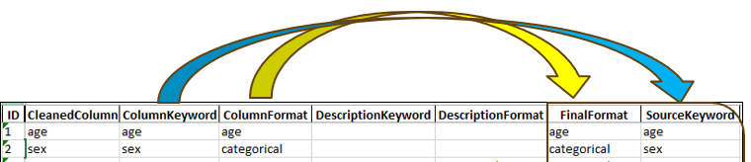
Attribute-Based Semantic Type Detection
'Final Format' receives the final data type detection either from the 'Column Format' or from the 'Description Format':
Milestone 1

Slide 28
Attribute-Based Semantic Type Detection
'Final Format' receives the final data type detection either from the 'Column Format' or from the 'Description Format':
Heuristics Rule is adopted
Milestone 1

Slide 29
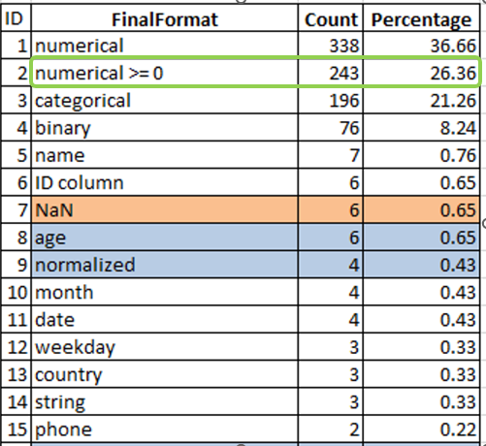
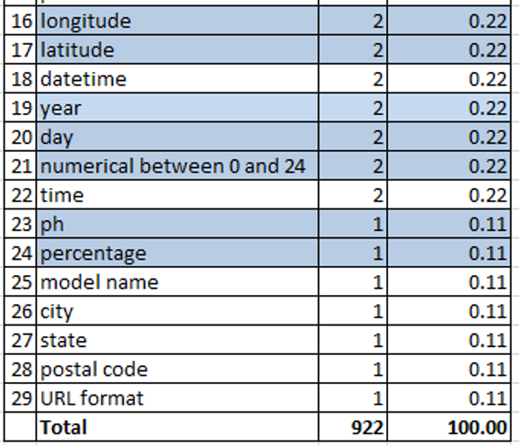
Attribute-Based Semantic Type Detection
Here is the final Frequency Distribution of the 922 attributes/columns:

Slide 30

Back to Methodology

Slide 31
Attribute-Based Data Quality Assessment
Following previous semantic type detection, it analyses the attributes and contents of the selected datasets, aligning with Appendix 1 (Data Quality Issues and Dimensions).
The high-level algorithm and explanations are in the Appendices.
Milestone 1

Slide 32

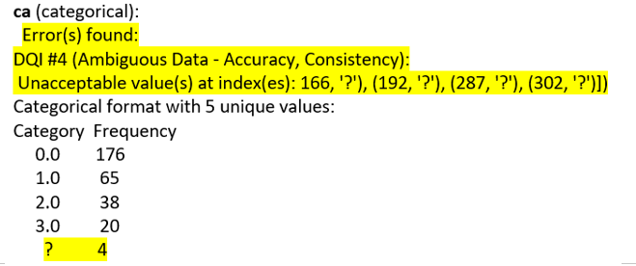
Attribute-Based Data Quality Assessment
This is one of the 106 Data Quality Issues found:
The complete output from 50 datasets and 922 columns/ attributes is available on GitHub ('Discoveries on the ten datasets.pdf ' and 'Discoveries on the forty datasets.pdf ' [Silva, 2024]).

Slide 33
Attribute-Based Data Quality Assessment
Interesting results
Found '?’ in 14 datasets and 77 columns/attributes.
Implausible negative values (e.g., humidity levels)
Geographical formats (such as capitalisation errors in city, street, state, and country)
Advanced Error Detection:
identified non-numerical values in numerical columns (e.g., 'InvoiceNo') and,
empty and numerical values in the 'Description' column, a String column.

Slide 34
Attribute-Based Data Quality Assessment
'Missing Value' analysis
The content '?’ was found in 77 columns/attributes out of the 106 total Data Quality Issues.
Considering it as a 'Missing Value', which seems to be the case as the Attributes Information from UCI declared it, and
if we add the three cases where '' was found and
one 'NA', we arrive at 81 columns where Missing Values were found.

Slide 35
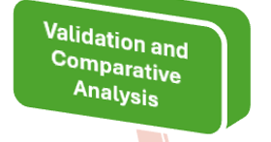
Back to Methodology

Slide 36
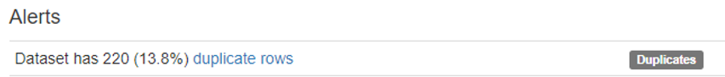

Validation and Comparative Analysis
YData Profiling (previously Pandas Profiling) is the best performing Exploratory Data Analysis (EDA) and Data Profiling open-source library in Python [Gordon et al., 2022]
They provide Alerts such as these :
They do provide many other Alerts than these, but they do not follow the Data Quality Issues presented in Appendix 1.
Notes:
Data Quality is the area I pursued my Master’s Degree in the USA. It is and will always be the background for me. I have been responsible to this area in my organization for many years.

Slide 37
Validation and Comparative Analysis
Situation | Our research | Ydata Profiling Alerts
Content ‘?’ | 77 | 0
Missing Values | 81 | 1
Negative Values | 2 (e.g. Humidity) | 0
Geographical and Temporal data | 5 | 0
Non-String and Non- Numerical data | 4 | 0
Time and others | 11 Analysed and validated | 11 Unsupported
Notes:
Data Quality is the area I pursued my Master’s Degree in the USA. It is and will always be the background for me. I have been responsible to this area in my organization for many years.

Slide 38
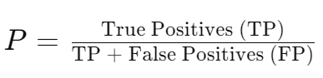
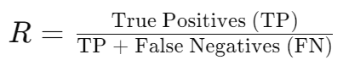
Validation and Comparative Analysis
Precision, Recall, and F1 Score Calculation
The only Data Quality Issue that can be compared is the Missing Data Issue, considering all 922 attributes:
Precision (P) measures the accuracy of the positive predictions (i.e., the proportion of positive identifications that were actually correct).
For our method:
TP for Missing Values = 81 (assuming all Missing Values we identified are correct)
FP for Missing Values = 0 (assuming no incorrect Missing Values were identified, as we don't have evidence to the contrary)
Therefore, P = 81/(81 + 0) = 100%
Recall (R) measures the proportion of actual positives that were identified correctly (i.e., the ability of the model to find all the relevant cases).
For our method:
TP for Missing Values = 81
FN for Missing Values = 0 (since YData identified only one case that we also identified; we can assume there are no FNs for Missing Values)
Therefore, R = 81/(81 + 0) = 100%
Notes:
Data Quality is the area I pursued my Master’s Degree in the USA. It is and will always be the background for me. I have been responsible to this area in my organization for many years.

Slide 39
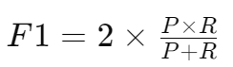
Validation and Comparative Analysis
Precision, Recall, and F1 Score Calculation
For YData Profiling:
TP for Missing Values = 1 (since they identified one case that we also agree with)
FN for Missing Values = 81 - 1 = 80 (all the cases they missed)
Therefore, R = 1/(1 + 80) = 1.23%
F1 Score is the harmonic mean of Precision and Recall, a measure that takes both FP and FN into account.
For our method, since P and R are both 100%, the F1 score is also 100%.
For YData Profiling:
Given P is 100% (as they made one correct prediction and no wrong predictions for missing data)
And R is 1.23%
The F1 score for YData would be: F1 = 2 x (1 x 0.0123)/(1 + 0.0123) = 2.44%.
Notes:
Data Quality is the area I pursued my Master’s Degree in the USA. It is and will always be the background for me. I have been responsible to this area in my organization for many years.

Slide 40
Ethics
I applied for Human Ethics but received information from Heather Johnson that there is ‘no case to answer’.

Slide 41
Dissemination Plan
Following Professor Felix Naumann's advice, our research paper was broken into two:
'Deriving Knowledge from Attribute Labels for Data Quality Assessment', to be sent to a database conference such as VLDB or EDBT;
A second Research Paper to be sent to the ACM - Journal of Data and Information Quality with the title of the Thesis: 'Attribute-Centric Approach for Data Quality Assessment in Diverse Datasets and Domains’.
It will have all the other items from the Milestone 1 document, including the A-DQAF, Alerts and Explainability, updated with the analysis of fifty new datasets from other sources and improved dictionaries and codes.

Slide 42
Dissemination Plan
Timeline:
Database Conference submission: Q2-Q3 of 2024.
ACM JDIQ paper submission: Planned for 2025 upon completion of additional datasets analysis and validation.
Curtin University student engagement and Data Science community: Throughout the academic year of 2024-2025.
Ongoing dissemination via GitHub (started in 2023).

Slide 43
Ethics and Authorship
Ethics Application
Authorship Agreement

Slide 44
Dissemination Plan
List of Produced Files for Dissemination:
The updated codes of the two main programs, 'Attribute-BasedSemanticType Detection.ipynb' and 'Attribute-BasedDataQualityAssessment.ipynb';
The updated dictionaries: 'formats_dictionary.txt' and 'abbreviations_dictionary.txt';
The source files for the two Semantic Type Detection analyses: 'TenDatasets.xlsx' and 'FortyDatasets.xlsx', and the 'AllColumnsFromTenDatasets.xlsx' and 'AllColumnsFromFortyDatasets.xlsx' which contain all the required data for the Data Quality Assessment of the fifty datasets with their column names/attribute labels as well as their descriptions.
The output of the 'Attribute-BasedSemanticTypeDetection.ipynb' code, the 'AnalysedColumns.xlsx' file, which contains the full Semantic Type Detection result, including the proposed format and words considered for all 922 columns in the fifty datasets.
The 'Attribute-BasedDataQualityAssessment' code used the 'TenDatasets.xlsx' and 'FortyDatasets.xlsx' files as well as the 'AnalysedColumns.xlsx' and each one of the fifty dataset content files, obtained on the internet so that all content could be verified against the formats previously suggested in the 'Attribute-BasedSemanticType Detection'.
For each set of datasets, a collection with all the outputs produced from each execution of a single dataset created two documents with all discoveries: 'Discoveries on the ten datasets.pdf' and 'Discoveries on the forty datasets.pdf'. These documents were enhanced with Alert analyses obtained from executions of ‘YData Profiling’ in all fifty datasets.
Lastly, a spreadsheet titled 'SummaryofDiscoveries.xlsx' was created. It contains four sheets obtained from the Discoveries documents: One with Data Quality Issues (DQIs) found with Created errors so that the functions could be tested, one with DQIs found in the 18 datasets that contained this output, one with the detail by each column, and the last one centred on the Data Issues so that it becomes easy to see the 77 ‘?’s that were found in the 106 different Data Quality Issues.

Slide 45
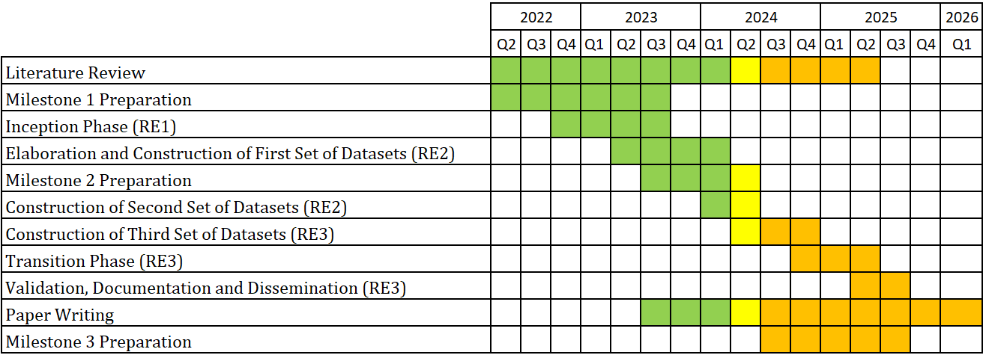
Completion Plan
Timeline from Milestone 1 document, updated for the current period, continuing with the Unified Process Methodology for the PhD:

Slide 46
Conclusion
This research produced an
Attribute-Based Semantic Type Detection using comprehensive Formats and Abbreviations dictionaries and Attribute-Based Data Quality Assessment highlighting the importance of attribute labels or column names/headers
Our method handles various data types that are not handled by other data quality methods.
Appendix 1 anchors our work in academic rigour, detailing data quality dimensions and issues.

Slide 47
Conclusion
Particularly noteworthy is our method's capability to identify 81 instances of missing values out of 922, significantly outperforming tools like YData Profiling, which detected only one.
Our method was validated across 50 datasets from the UCI Machine Learning Repository, highlighting its potential to revolutionise data quality.

Slide 48
Future Work
• Machine Learning Integration (Sherlock) for automated semantic type detection
• Fifty additional datasets from varied sources other than UCI
• Adhering to ISO Standards
• Enhancing Resources (dictionaries)
• A second publication with the rest of the PhD.

Slide 49

https://stock.adobe.com/au/search?k=thank+you+in+different+languages

Slide 50

https://stock.adobe.com/au/search?k=questions+and+answers&asset_id=86681903

